Slide 1
FUNDAMENTALS OF
SPACTIAL FILLTERING
Notes:
Today I’ll be presenting on FUNDAMENTALS OF SPACTIAL FILLTERING
– a fundamental technique used to enhance image quality before deeper analysis.

Slide 2
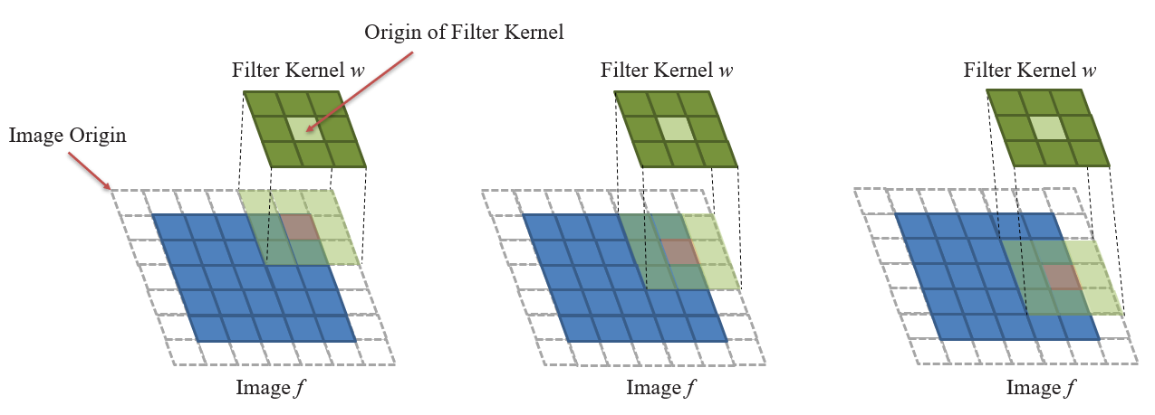
SPACTIAL FILLTERING
Spatial filtering modifies pixel values using their neighbors.
Operates in the spatial domain
Used for:
Smoothing
Sharpening
Edge detection
Notes:
Spatial filtering is the process of modifying a pixel value by considering the values of its surrounding neighbors.
This technique operates directly in the spatial domain of the image.
It is used for smoothing, enhancing, or detecting edges.
A linear spatial filter performs a sum-of-products operation between an image f and a filter kernel, w.
A filter kernel is a matrix that have size 3x3, 5x5 and so on.
Any terms used to refer to a spatial filter kernel are mask, template, and window.

Slide 3
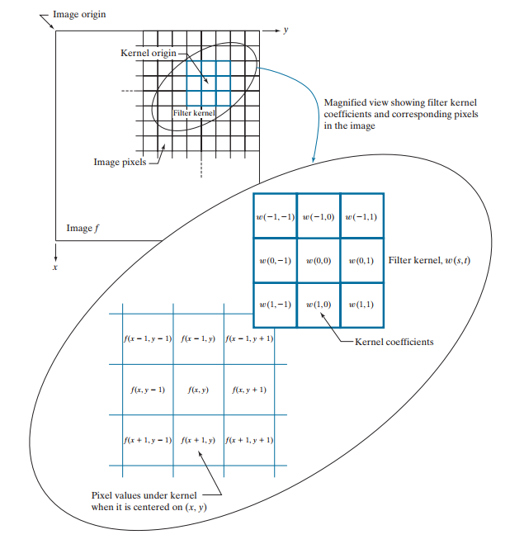

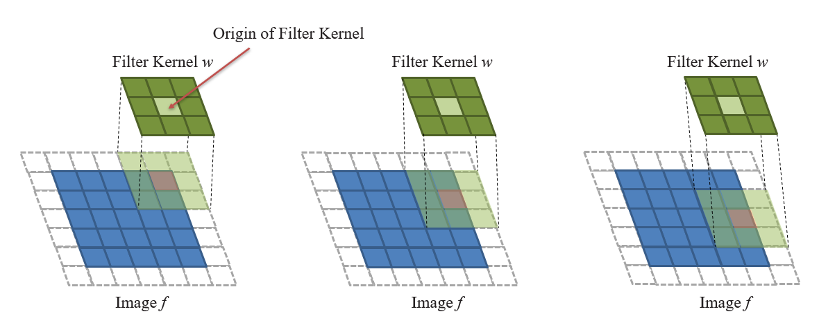

How it work ?
With a kernel of size m x n m = 2a + 1 and n = 2b + 1
Notes:
This figure illustrates the mechanics of linear spatial filtering using a 3 multiply 3 matrix.
At any point (x, y) in the image, the response, g (x , y), of the filter is the sum of products of the kernel coefficients and the image pixels encompassed by the kernel: As coordinates x and y are varied, the center of the kernel moves from pixel to pixel, generating the filtered image, g, in the process.
Observe that the center coefficient of the kernel, w( , 0 0), aligns with the pixel at location ( , ). x y
From the formula above, we derive the general formula as shown here.
For a kernel of size m multiply ν , we assume that m a = + 2 1 and n b = + 2 1
s takes values from Negative a to a. and t have range from Negative b to b

Slide 4
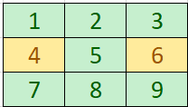

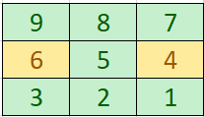

SPATIAL CORRELATION AND CONVOLUTION
w
Correlation
Rotated w
Convolution
Notes:
Correlation consists of moving the center of a kernel over an image, and computing the sum of products at each location. The mechanics of spatial convolution are the same, except that the correlation kernel is rotated by 180°.

Slide 5
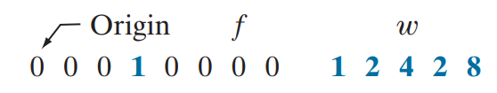
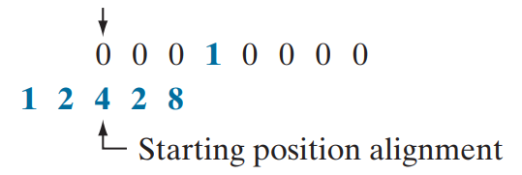
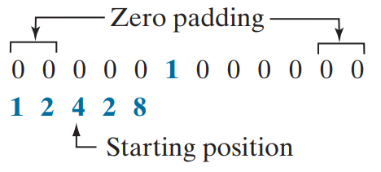
SPATIAL CORRELATION AND CONVOLUTION
Correlation
W size 1 x 5 (1 x m)
=> Padding (m – 1) / 2 = 2 zeros on either side
Notes:
An example of a 1-D function, f, and a kernel, w. Due to the center of the kernel coincides with the origin of the image, we need set part of w lies outside f.
So the summation is undefined in that area.
A solution to this problem is to pad function f with enough 0’s on either side.
In general, if the kernel is of size 1 ⋅ m, we need (m – 1) / 2 zeros on either side of f in order to handle the beginning and ending configurations of w

Slide 6




SPATIAL CORRELATION AND CONVOLUTION
Correlation
Start position
Result = 1x0 + 2x0 + 4x0 + 2x0 + 8x1
Position after 1 shift
Result = 1x0 + 2x0 + 4x1 + 2x0 + 8x0
Position after 3 shift
Final Position
Notes:
A function that contains a single 1 with the rest being 0’s is called a discrete unit impulse.
Correlating a kernel with a discrete unit impulse yields a rotated version of the kernel at the location of the impulse.
the result is a copy of the kernel, rotated by 180°

Slide 7
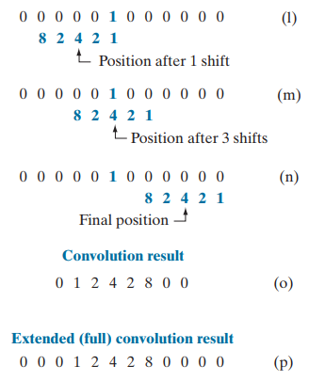
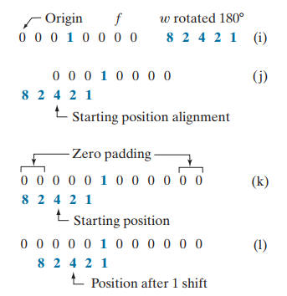
SPATIAL CORRELATION AND CONVOLUTION
Convolution
Notes:
You see again
that convolution of a function with an impulse copies the function to the location of the impulse.

Slide 8
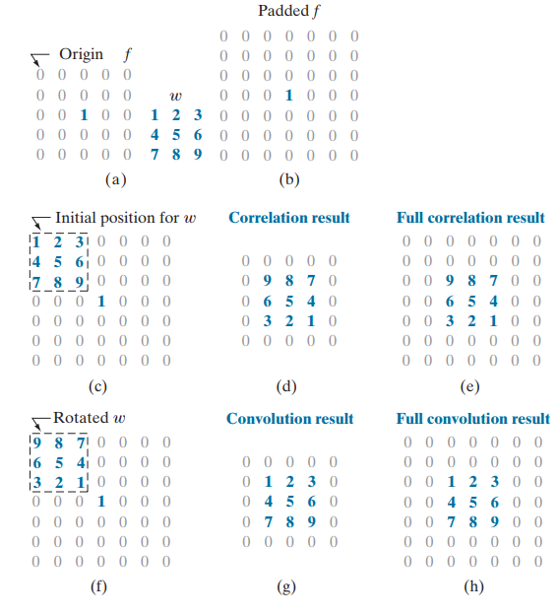
SPATIAL CORRELATION AND CONVOLUTION
Notes:
1-D function, f, and a kernel, w whose size is 3 x 3

Slide 9
SPACTIAL FILLTERING
Origin of Filter Kernel
Filter Kernel w
Filter Kernel w
Filter Kernel w
Image Origin
Image f
Image f
Image f
Notes:
A filter kernel is a matrix that have size 3x3, 4x4, etc

Slide 10
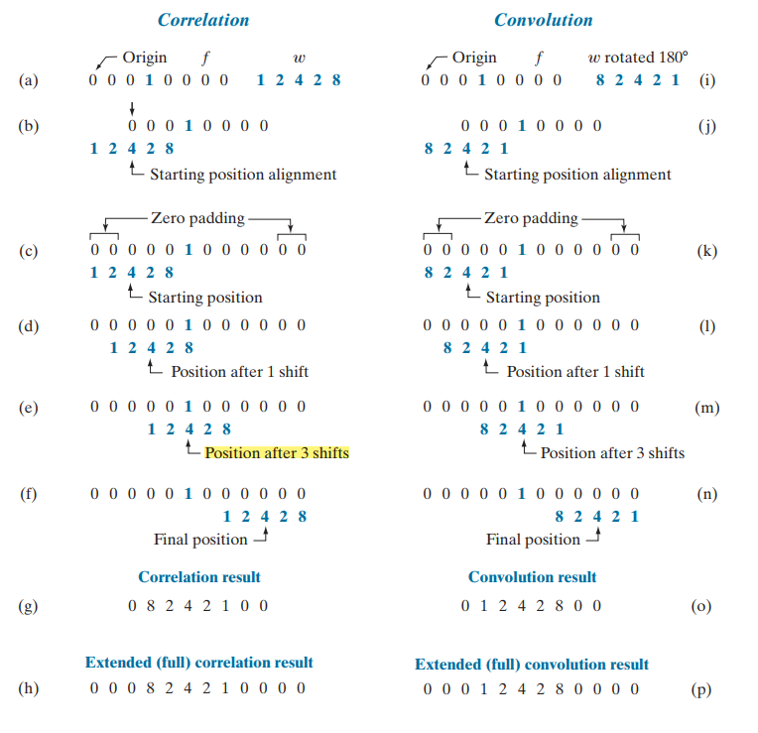
SPATIAL CORRELATION AND CONVOLUTION

